Slide 1
Using Google Analytics to Grow Your Business
Presented by Brenda Newhouse, Newhouse Studios Web Strategy, LLC

Slide 2
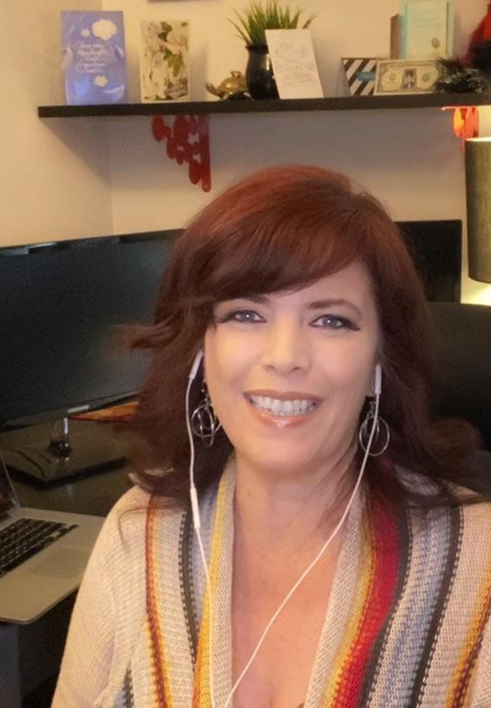
Brenda Newhouse
Web Strategist.
Professional
Web Design, SEO, and Online Marketing
Former Web Design MCC Instructor
Education
AAS, Web Design, MCC
BAS, Digital Media Management, ASU

Slide 3
What You’ll Learn
What content on your site keeps your visitors' attention.
How to see what words people use to find you in search engines.
Strategies to use the information in Google Analytics for new content ideas.

Slide 4
What is It?
Free Tracking Tool from Google
Where does your traffic come from
  Social media channels
  Paid ads
  Google search terms for your site
What people do on your site
  Page views
  Entry pages
  Exit pages
  Time on pages

Slide 5
Why Use It?
Learn Where to Invest Your Time and Money
  Which social media channels matter?
  Are your ads working?
  Which sites send you business?
  What pages do people engage with the most?
  Create less of the content that doesn't hold visitors' attention.

Slide 6
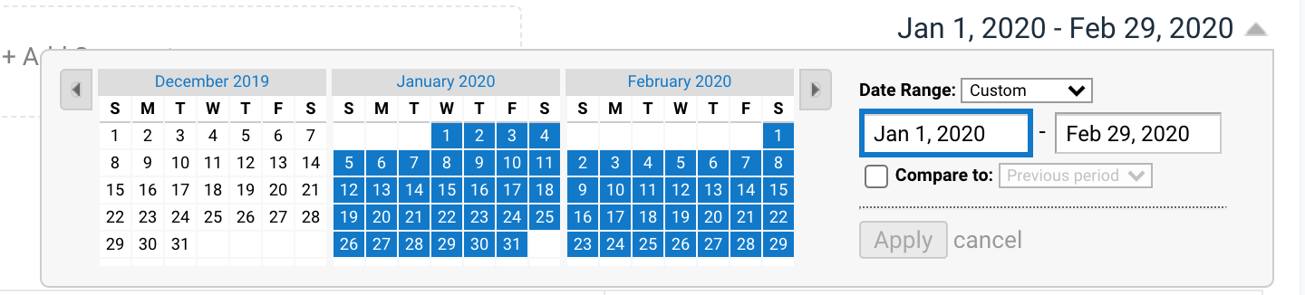

Slide 7
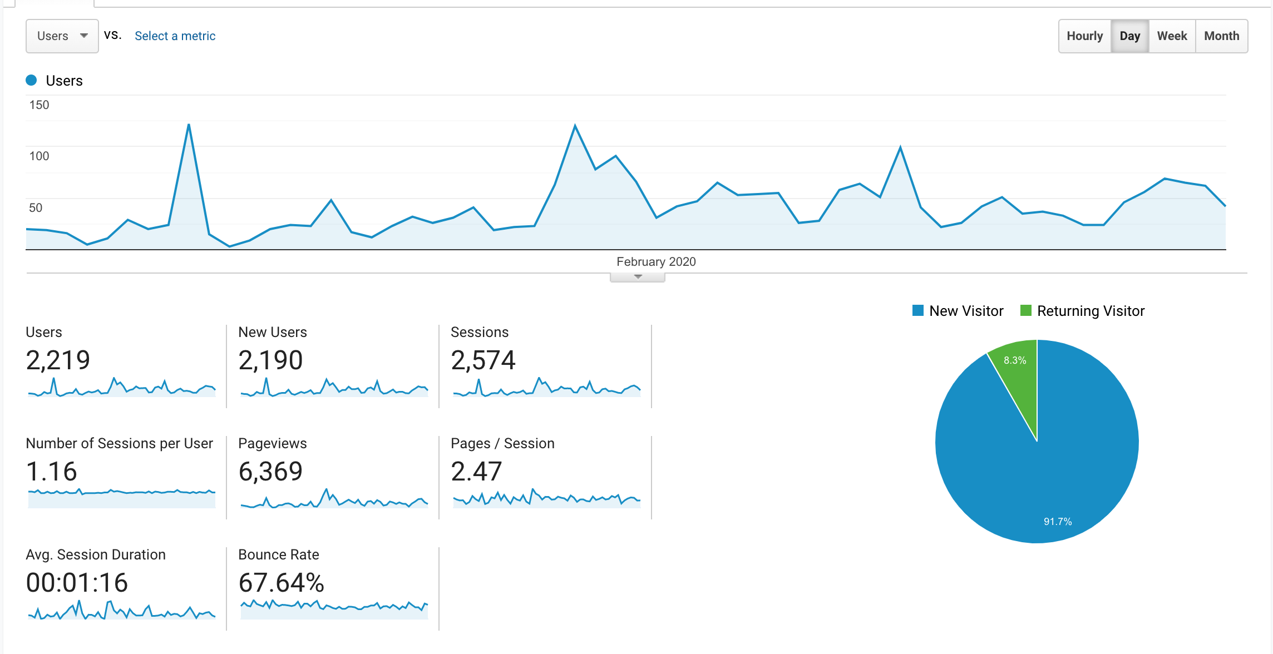

Slide 8
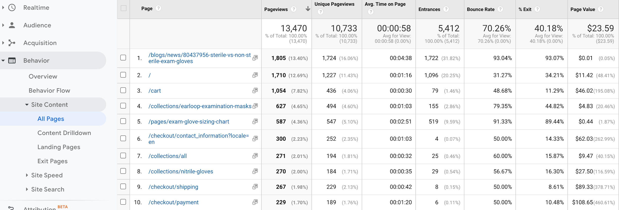

Slide 9
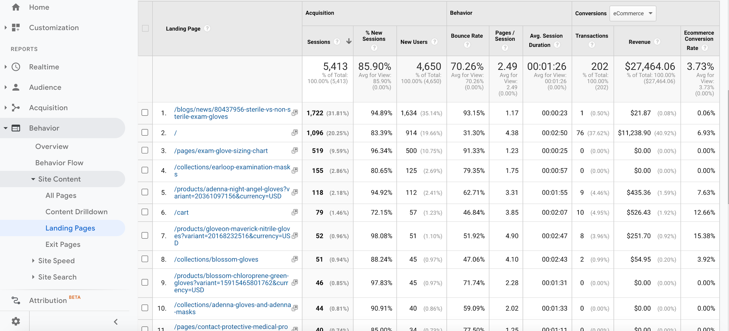

Slide 10
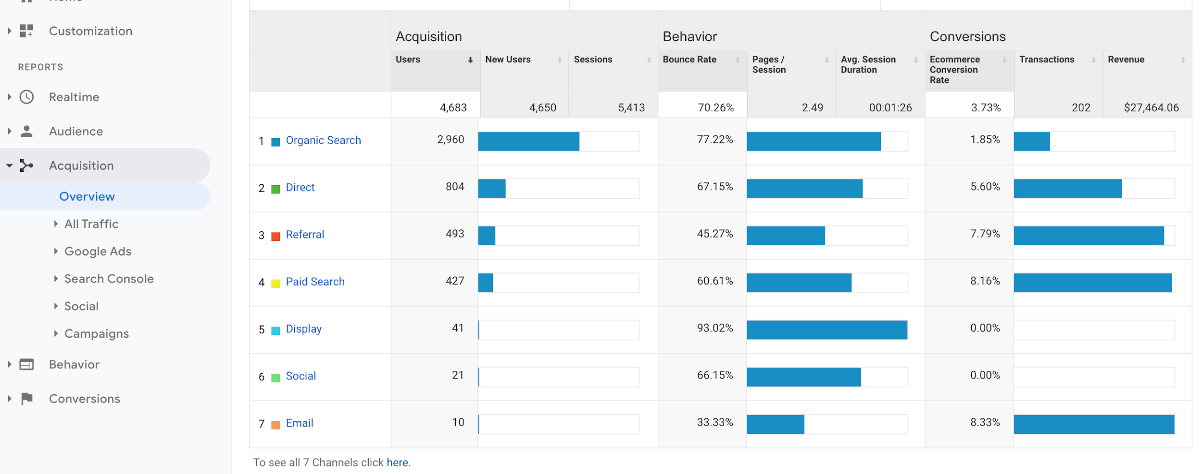

Slide 11
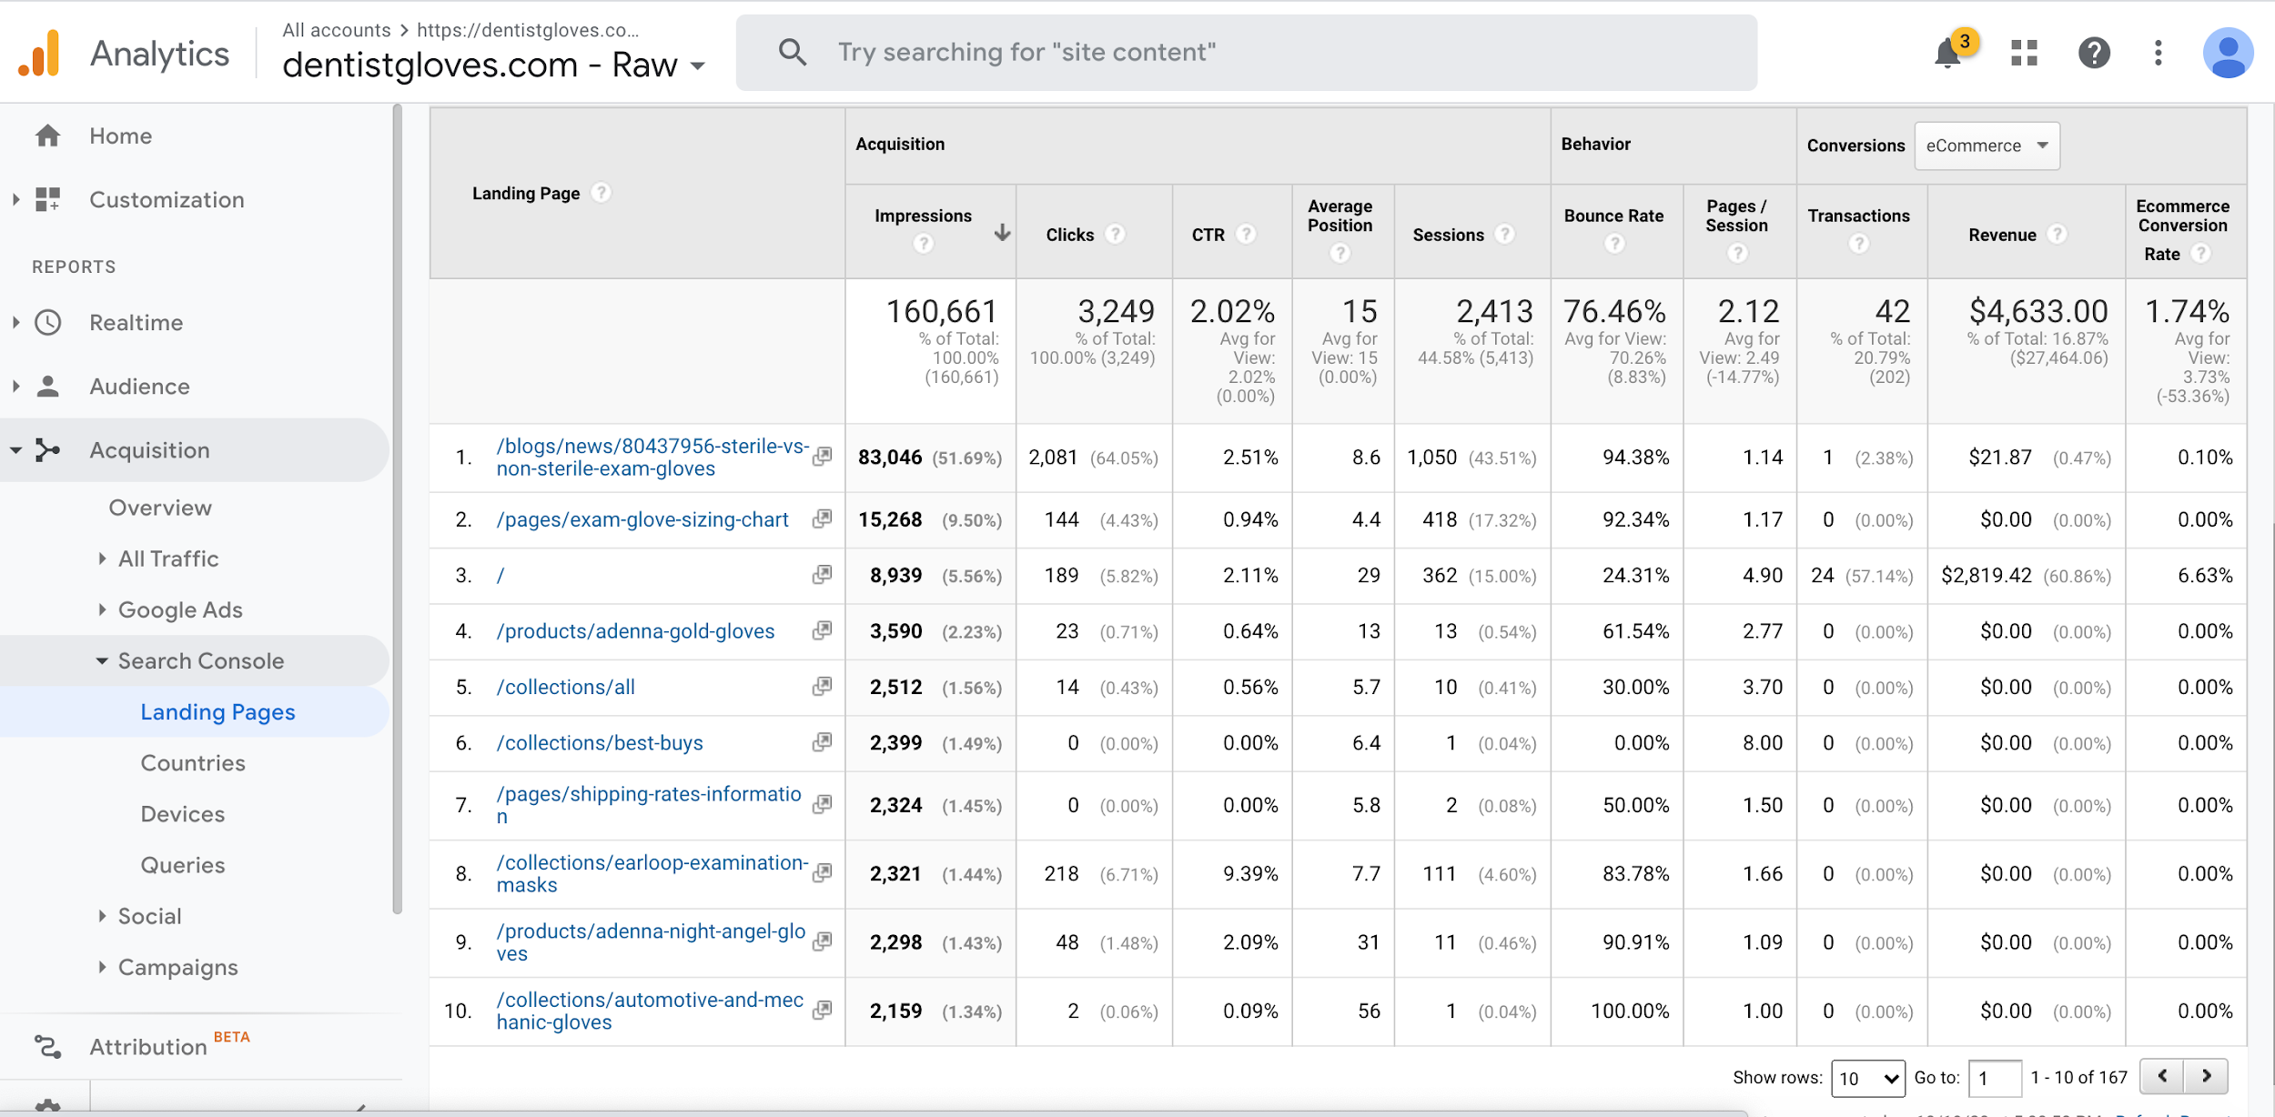

Slide 12
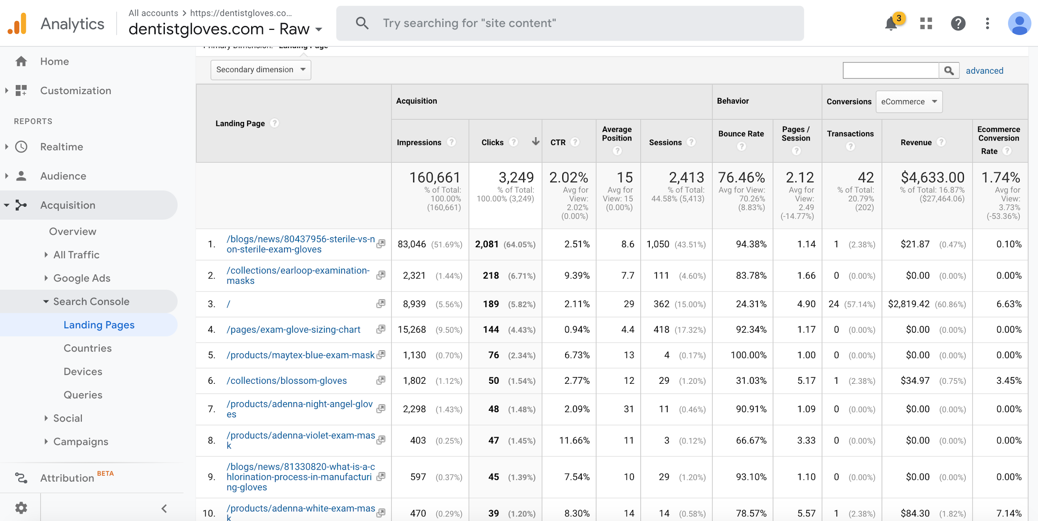

Slide 13
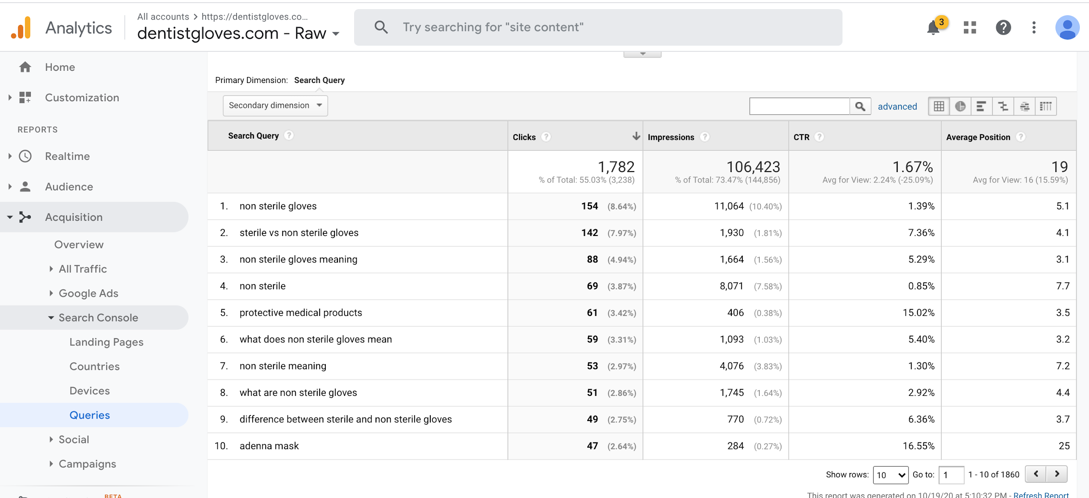

Slide 14
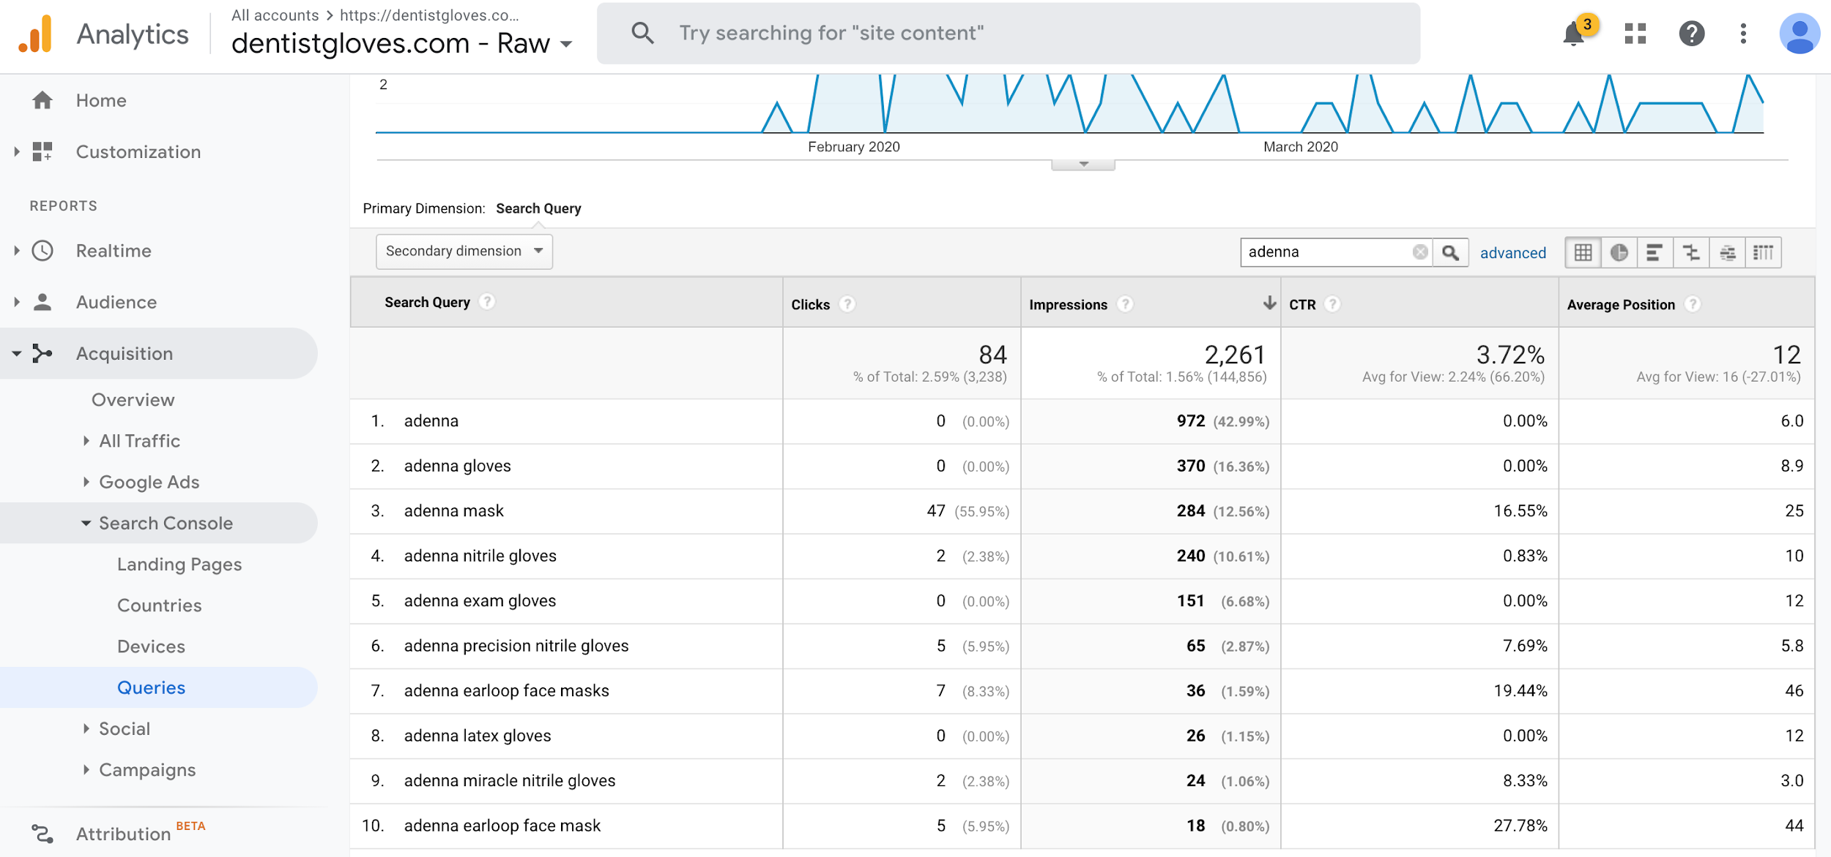

Slide 15
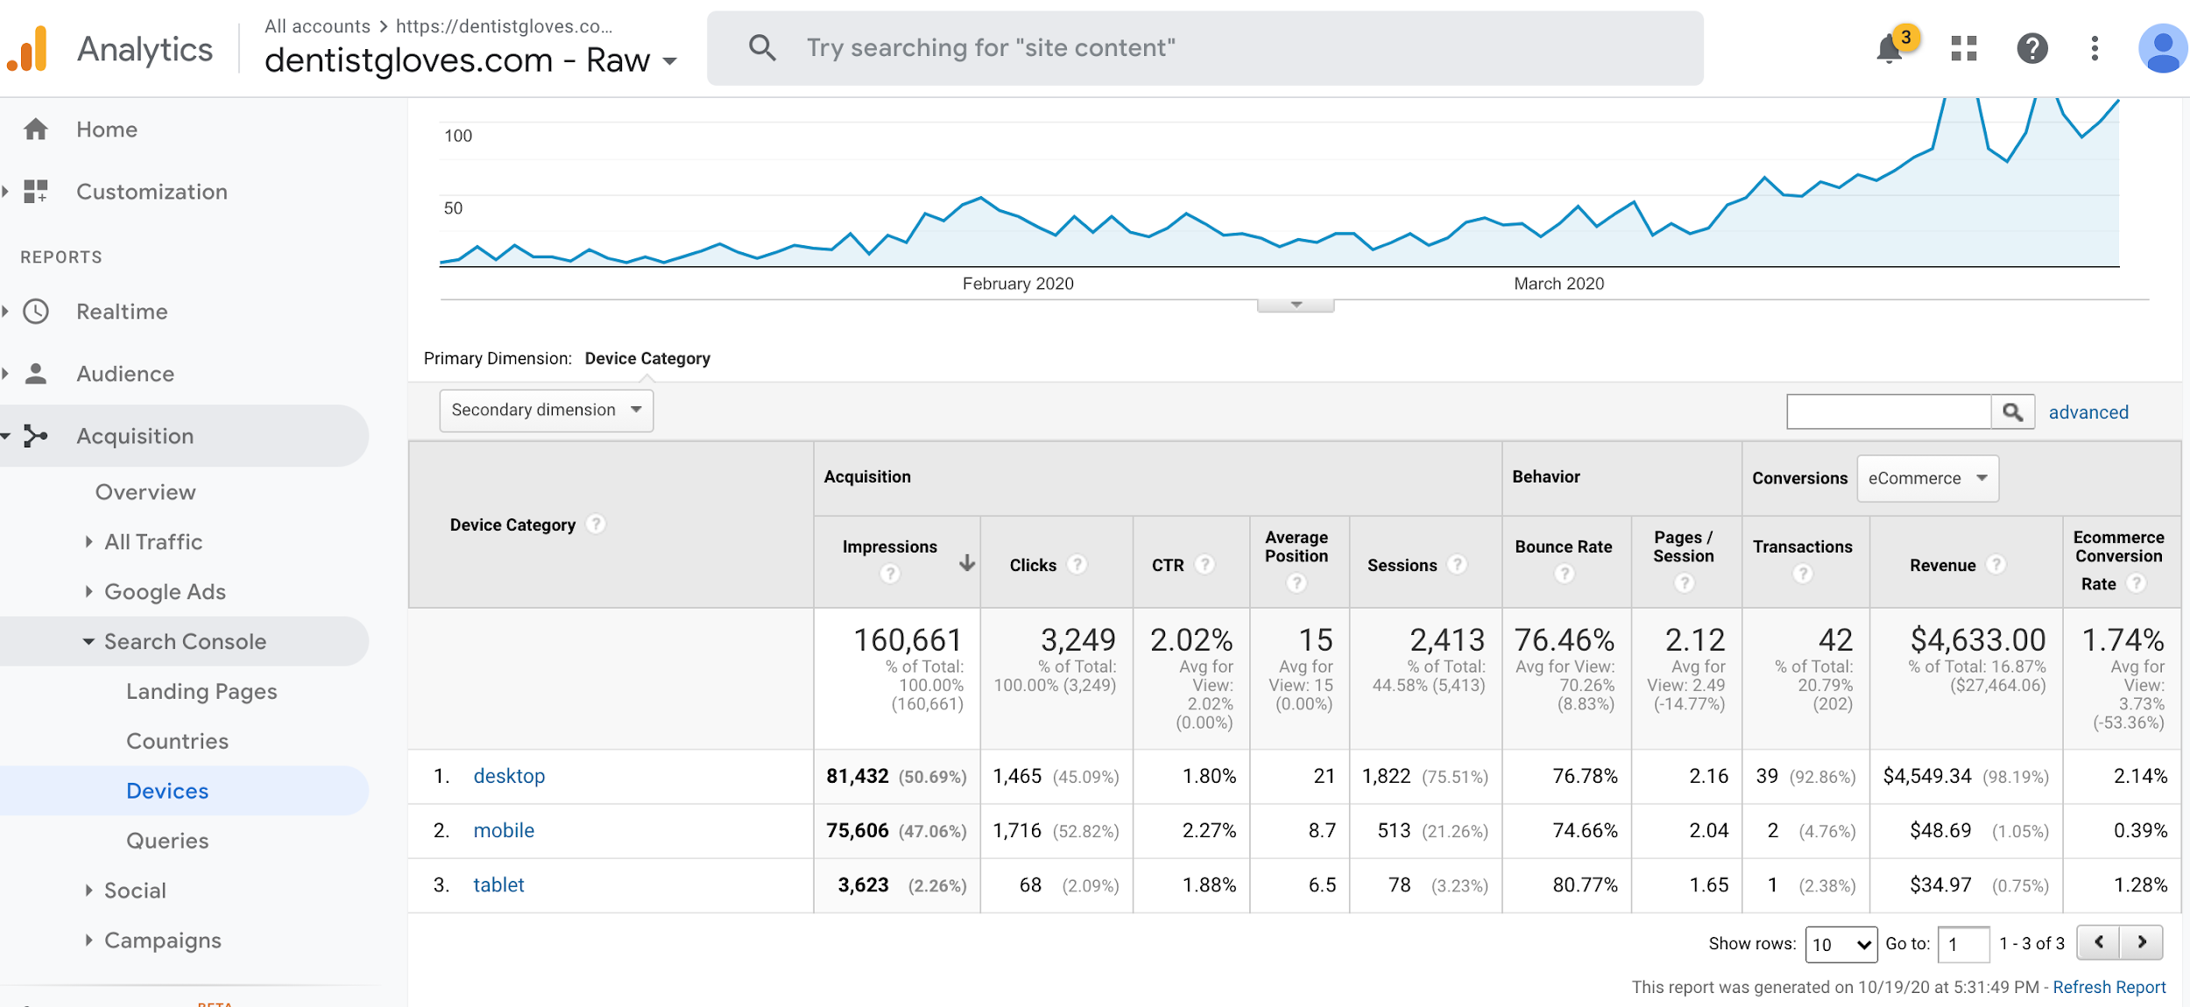

Slide 16
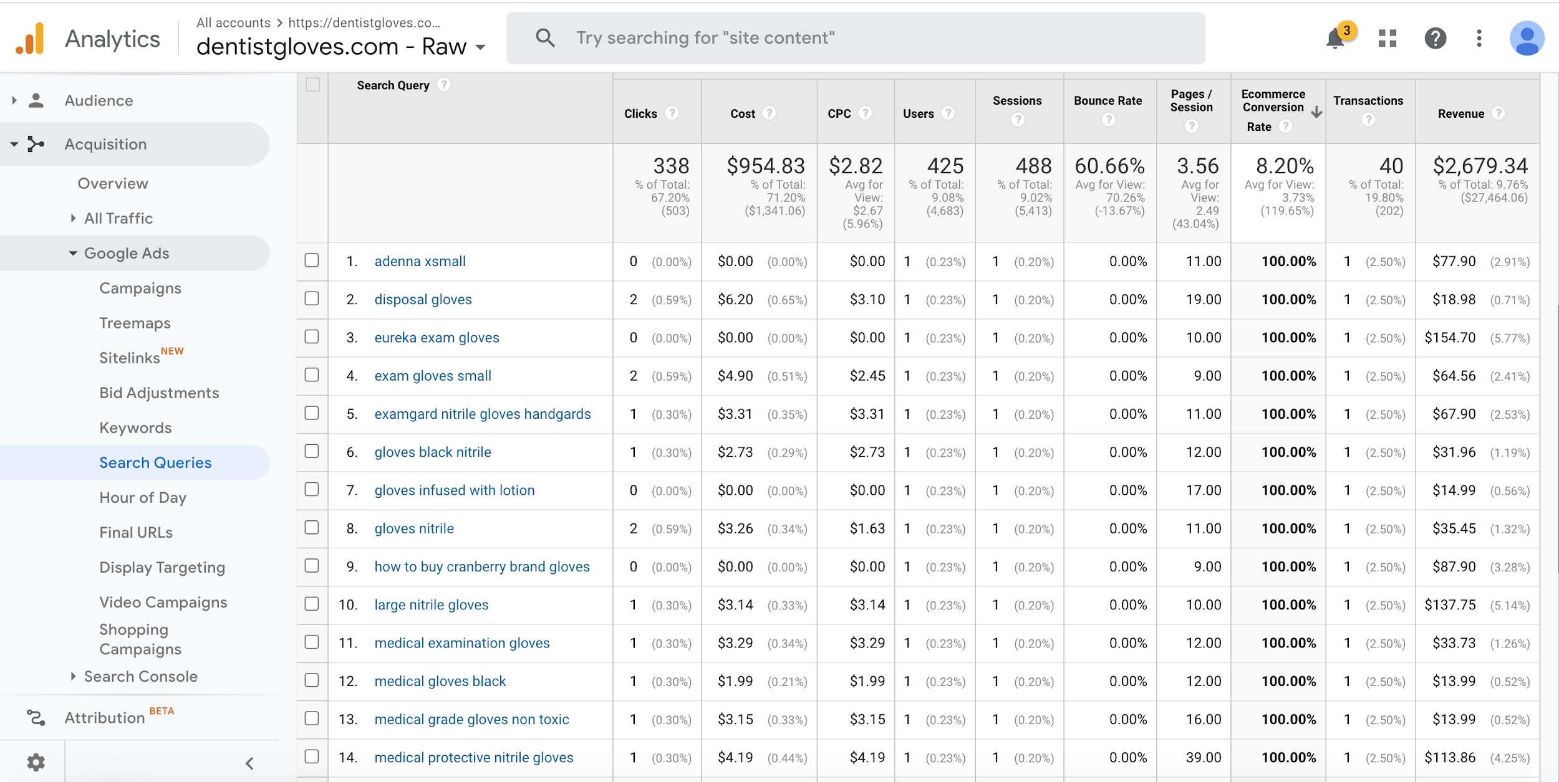

Slide 17
How to Create a Google Analytics Account
Use your own google account
https://analytics.google.com/analytics/web/
https://support.google.com/analytics/answer/1008015?hl=en
https://search.google.com/search-console/about
https://support.google.com/analytics/answer/1308617?hl=en
Connect the two products
https://support.google.com/analytics/answer/1308621

Slide 18
How to Set Up Google Analytics on Your Website
WordPress - https://www.monsterinsights.com/
Squarespace support page
https://support.squarespace.com/hc/en-us/articles/205815608-Using-Google-Analytics-with-Squarespace
Shopify support page
https://help.shopify.com/en/manual/reports-and-analytics/google-analytics/google-analytics-setup

Slide 19
Additional Resources
Loves Data - Ben Mangold
  https://www.lovesdata.com/
Google Analytics Academy
  https://analytics.google.com/analytics/academy/
LinkedIn Learning
  Google Analytics Essential Training with Corey Koberg
  https://www.linkedin.com/learning/google-analytics-essential-training-5/understanding-your-digital-customers-with-google-analytics

Slide 20
Questions?

