Slide 1
Get Found In Search Engines
Presented by Brenda Newhouse, Newhouse Studios Web Strategy, LLC

Slide 2
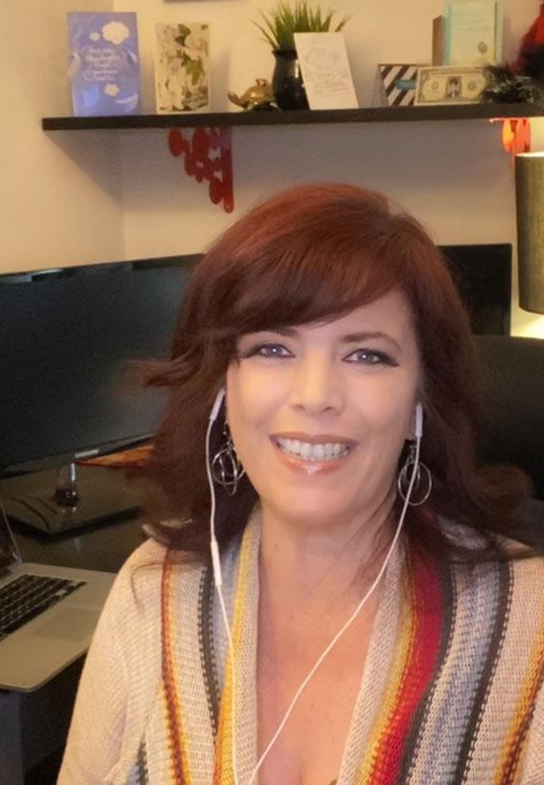
Brenda Newhouse
Web Strategist.
Professional
Web Design, SEO, and Online Marketing
Former Web Design MCC Instructor
Education
AAS, Web Design, MCC
BAS, Digital Media Management, ASU

Slide 3
What You’ll Learn
Research
Competing Website Rankings & Ideal Audience Searches
The Three Things
Information Every Website Page and Post Should Include for Search
Next Steps
Additional Resources

Slide 4
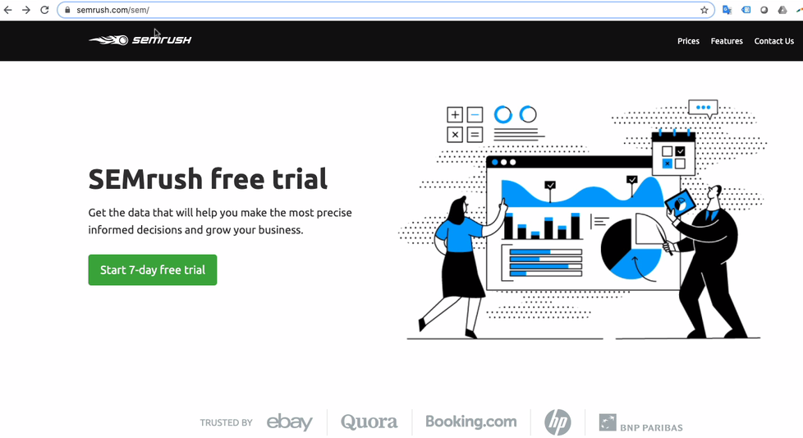

Slide 5
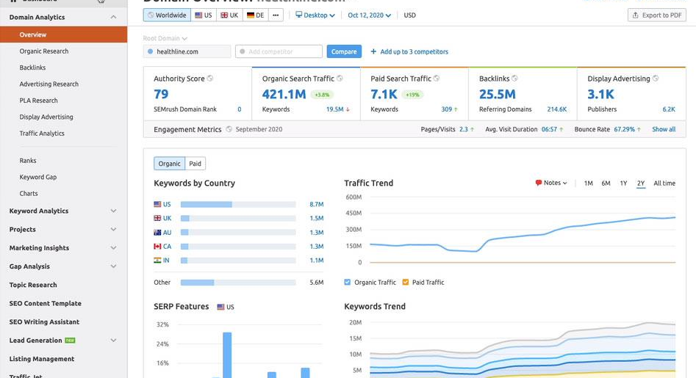

Slide 6
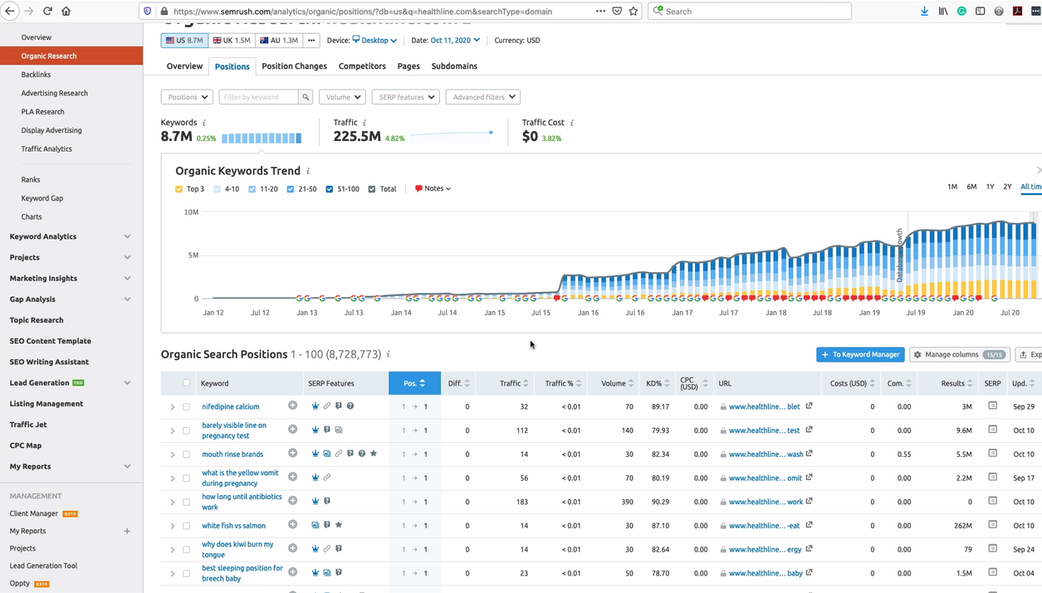

Slide 7
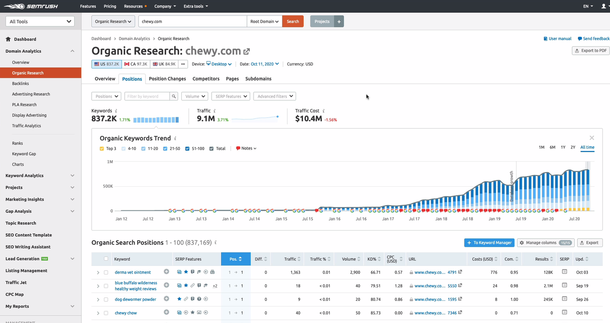

Slide 8
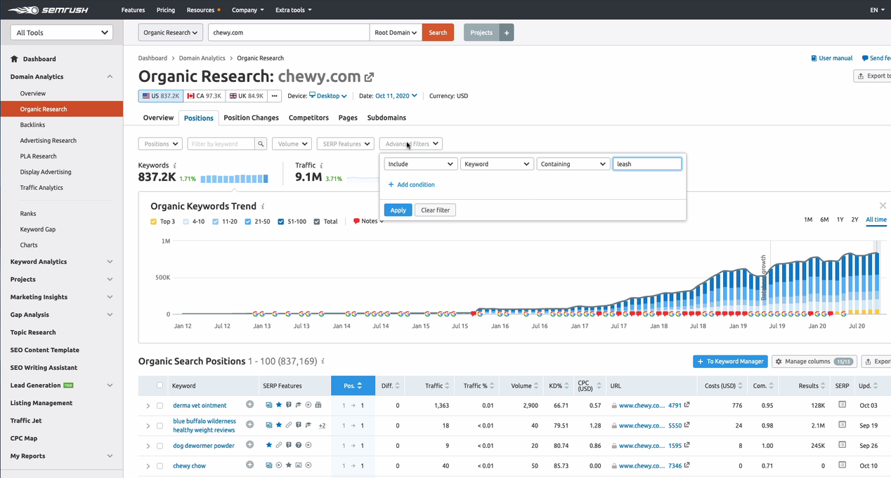

Slide 9
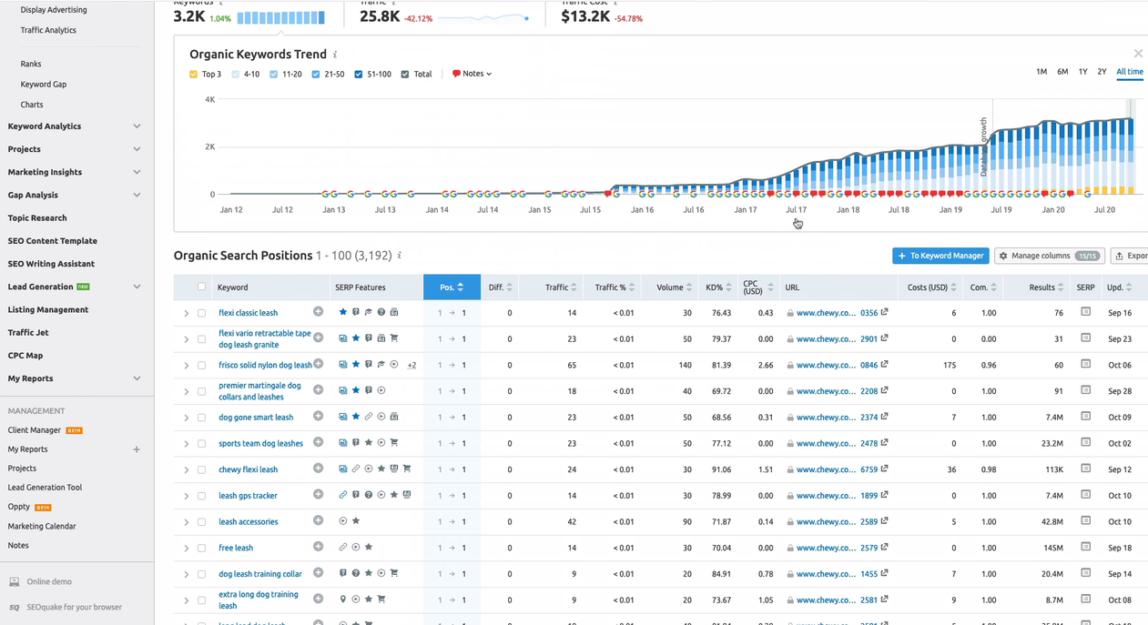

Slide 10
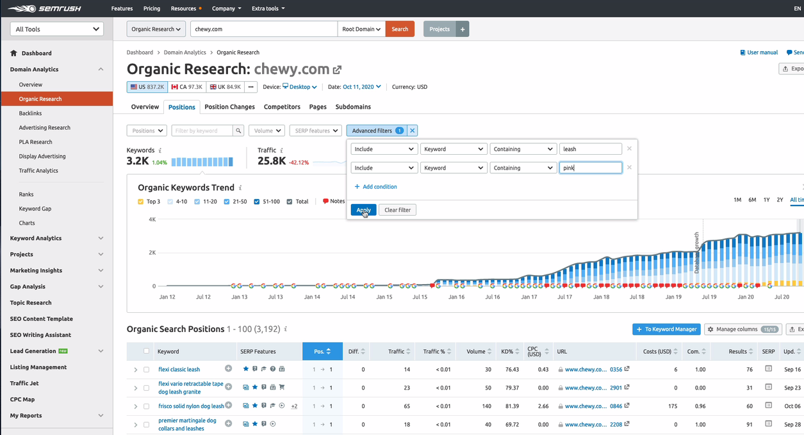

Slide 11
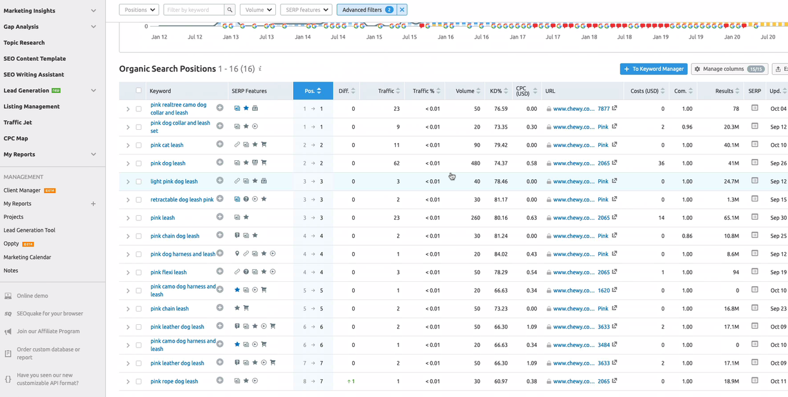

Slide 12
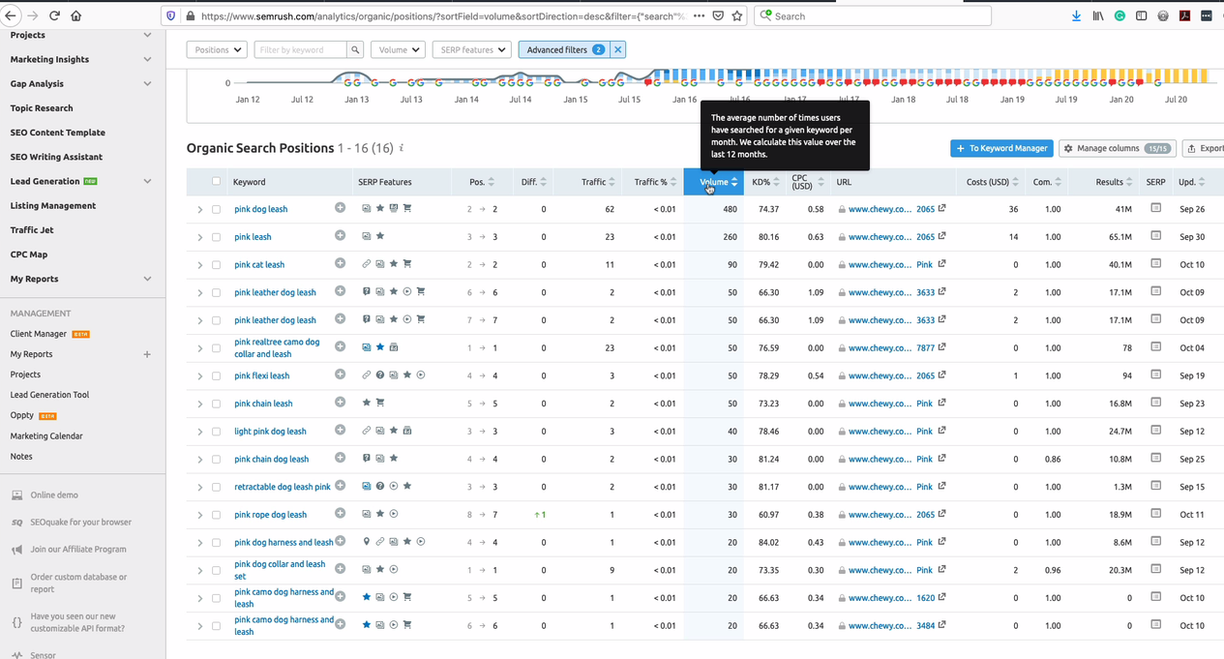

Slide 13
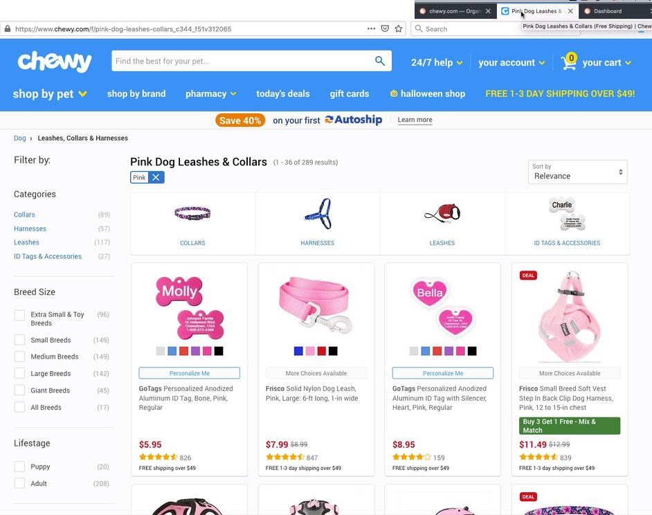

Slide 14
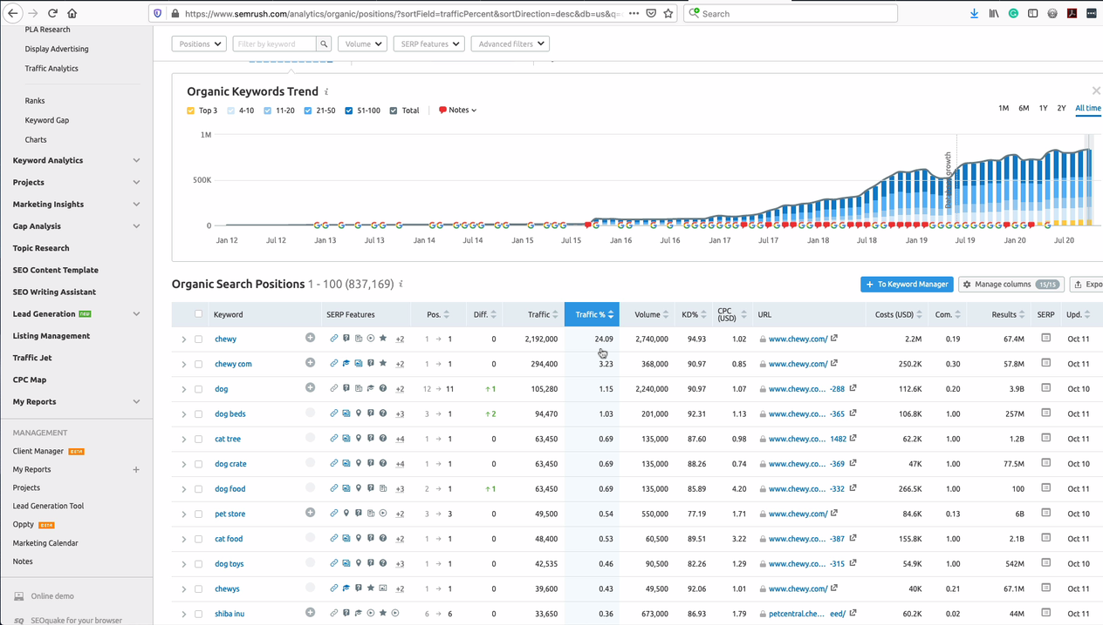

Slide 15
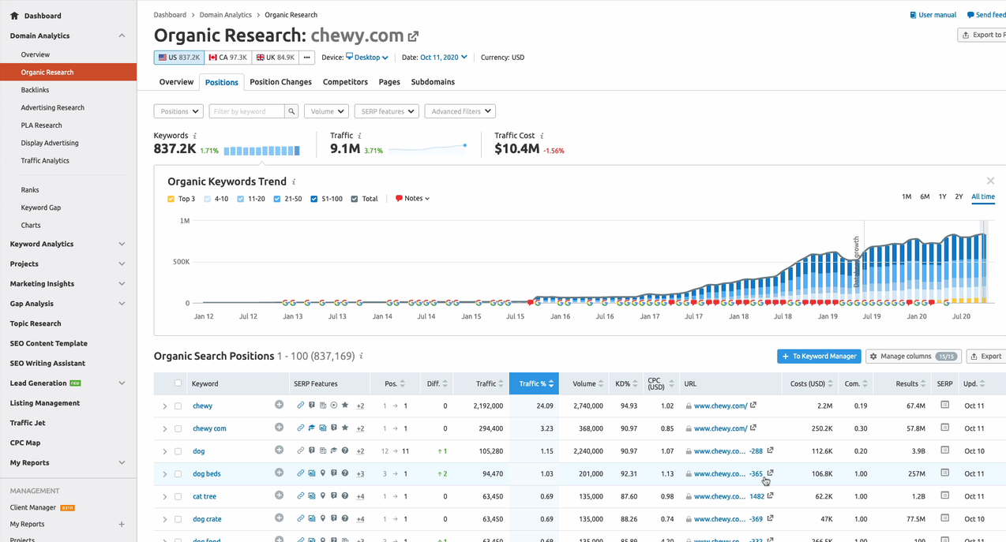

Slide 16
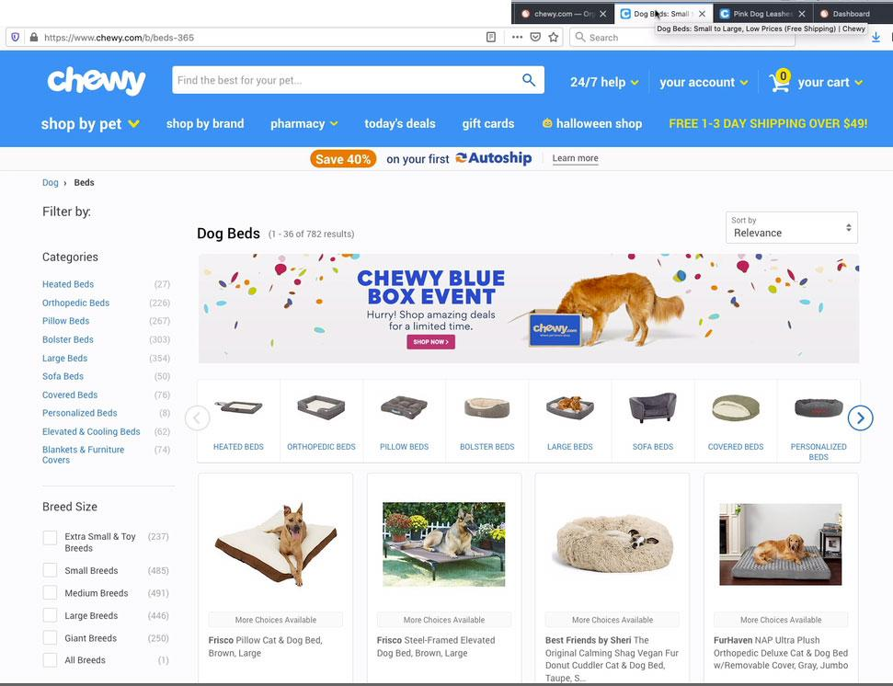

Slide 17
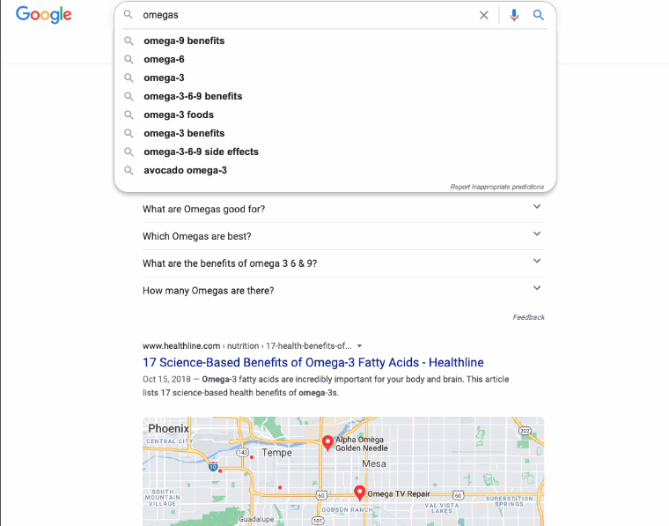

Slide 18
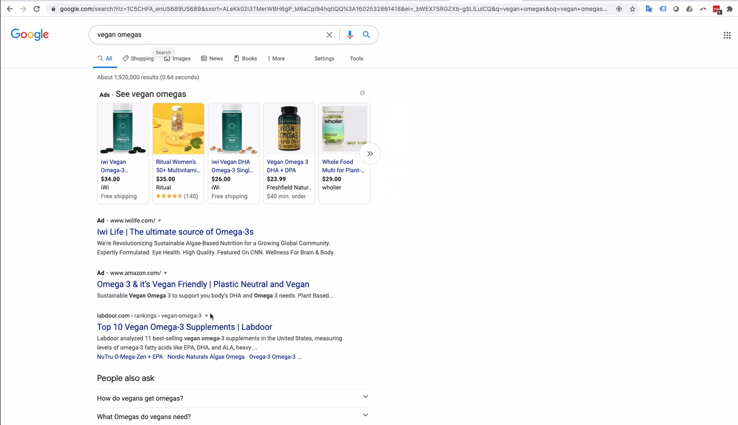

Slide 19
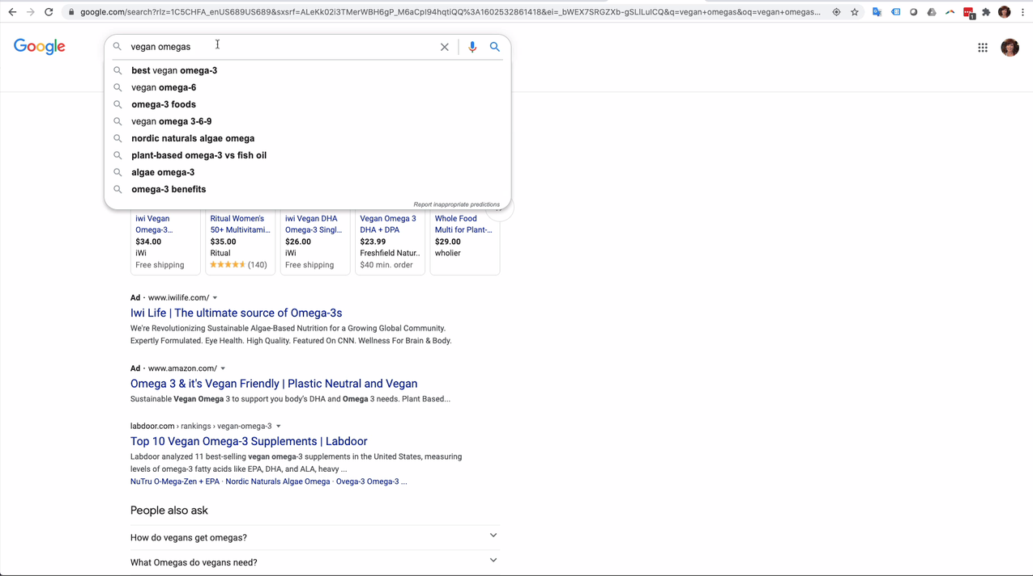

Slide 20
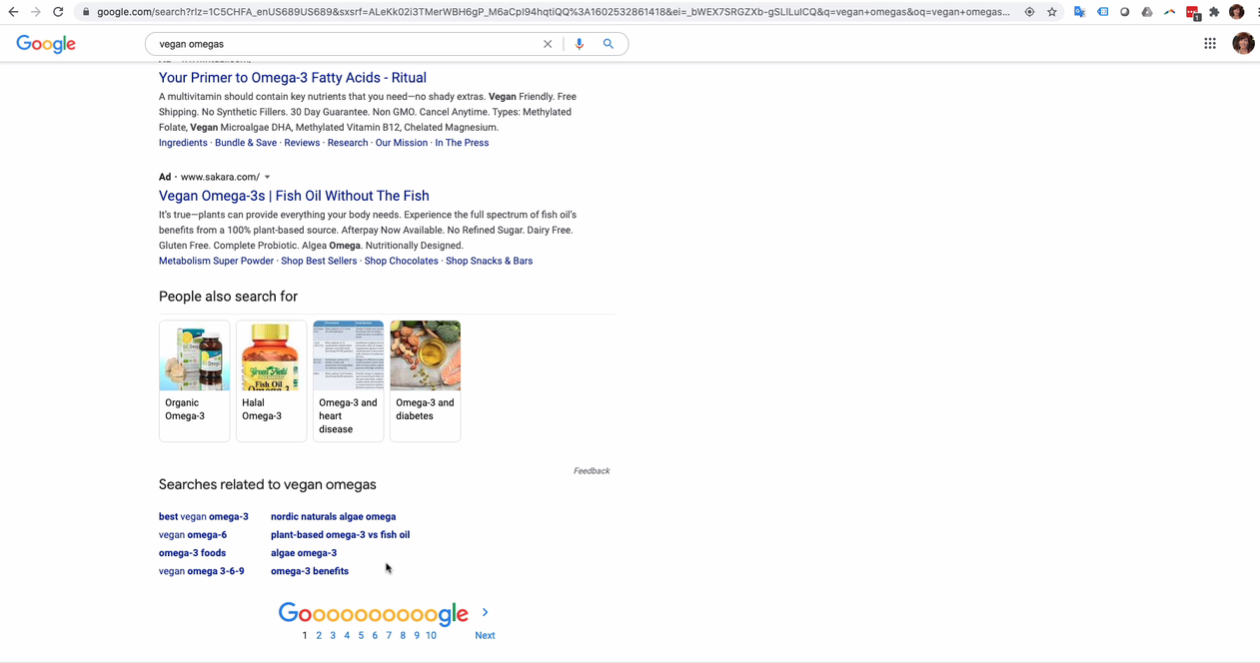

Slide 21
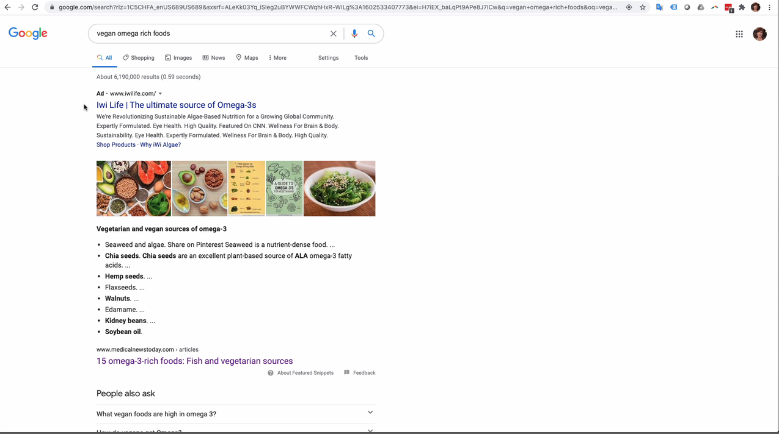

Slide 22
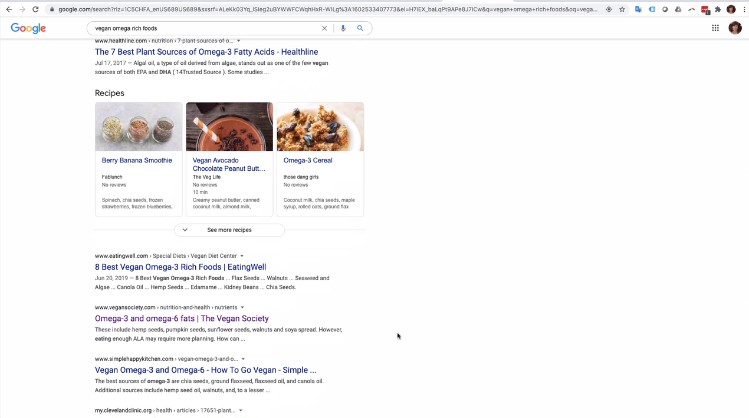

Slide 23
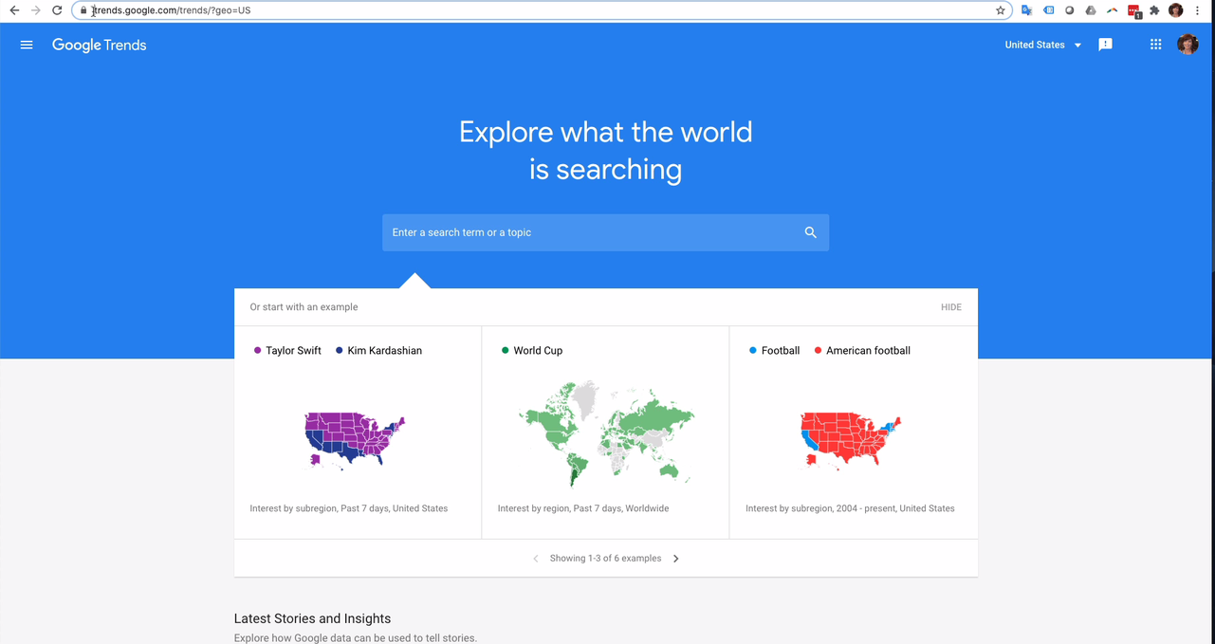

Slide 24
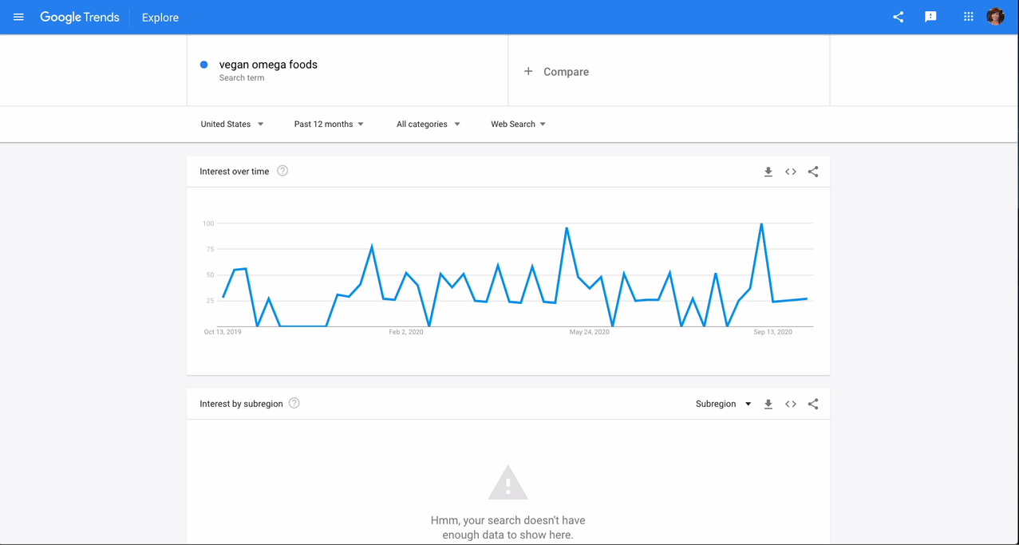

Slide 25
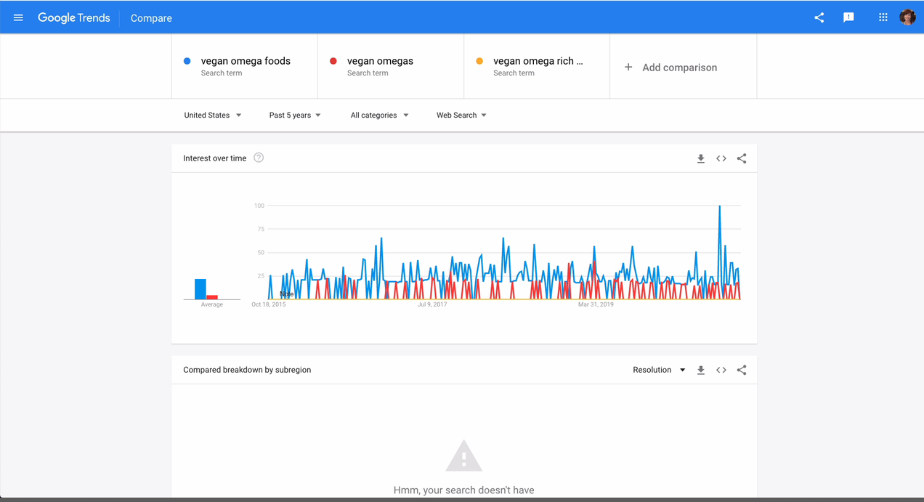

Slide 26
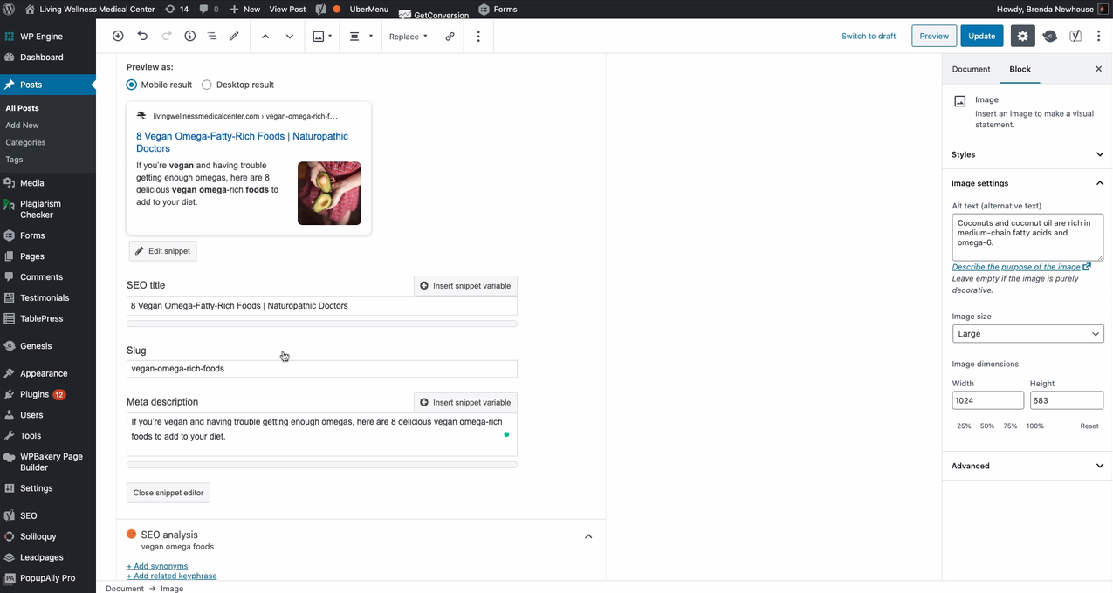

Slide 27


Slide 28
Additional Resources
BrendaNewhouse.com
Brian Dean’s YouTube Channel
https://brendanewhouse.com/blog/
https://www.youtube.com/user/backlinko
LinkedIn Learning
Research Sites
SEO Foundations with David Booth
SimilarWeb.com
SpyFu.com
UberSuggest.com

Slide 29
Questions?

